Slide 1
Faculty Senate Meeting
March 19, 2020
Zoom Meeting
https://umsystem.zoom.us/j/188307911
Meeting ID: 188 307 911

Slide 2
Agenda
Call to Order and Roll Call
K. Homan, Secretary

Slide 3
Agenda
Approval of Minutes
February 20, 2020

Slide 4
Agenda
III. Campus Reports
A. Staff Council
B. Spencer
-No Report

Slide 5
Agenda
III. Campus Reports
B. Student Council
K. Kessinger

Slide 6
Student Council Report
Faculty Senate
March 19, 2020

Slide 7
Student Council
Student Council will continue to meet over Zoom
At upcoming meetings, Student Council will discuss possible resolutions on:
CET Changes
Commencement Changes
Students can fill out a form on Student Council’s website (stuco.mst.edu) if they are having difficulties with the transition to online instruction.

Slide 8
Student Council
Student Leaders Awards
Form to nominate is open. It will close March 31st
There will not be an in-person event, but Student Council will continue to give out awards.
New Student Body President
Lawrence Hierlmeier
Major: Computer Science and Math
Hometown: Anaheim, CA
Term starts on May 1st

Slide 9
Agenda
III. Campus Reports
C. S&T General Oversight Committee
Jim Musser

Slide 10
General Education Oversight Committee
Status Report
Purpose
Charge
Membership
Plan
Progress

Slide 11
Purpose of General Education Revision
Interim Monitoring (if applicable)
Interim report on SLO [Student Learning Outcomes] and GLO [Graduate Learning Outcomes] differentiation on the following rationale:
As stated earlier, the site-visit team noted no differentiation among learning goals at the different academic levels. . . . Finally, the SLOs and GLOs are ten years old, and there is no review/change process in place to update them.
(continued on next slide from HLC Report p. 27)

Slide 12
Purpose of General Education Revision
(continued from previous slide)
The first item listed above should invite campus constituents to collaborative efforts aimed at reviewing learning goals at the different academic levels that support Missouri S&T's curricula. . . .
In light of the observed confusion on learning goals for general education, it is recommended that an institutional oversight body for general education be created, thus allowing for the development of clarity on specific expectations to be communicated across campus.
HLC Report p. 27

Slide 13
Purpose of General Education Revision
HLC report details indicate that General Education at S&T is
not well-defined,
not communicated clearly and
not implemented consistently.
Initial work by the S&T committee supports these conclusions.

Slide 14
Charge to the Committee
Develop a vision of what general education is/should be at S&T.
Create a campus-wide process for reviewing and revising campus-wide general education requirements.
Committee Goals
Review general education components.
Propose and develop a campus-wide general education curriculum.
Develop student learning outcomes (SLOs) for University Assessment Committee review.

Slide 15
Committee Membership
Faculty representatives from each department
Chair selected by the committee
General Faculty Involvement
Committee will educate faculty regarding
general education program options,
mandated elements and
committee recommendations.
Faculty select and approve program.

Slide 16
Committee Plan
Identify current S&T General Education program.
Learn about general education from external sources.
HLC
State of Missouri (CORE 42)
AAC&U
Other universities
Identify or write SLOs.
Simultaneously approach S&T from two approaches.
Unify current requirements and map to SLOs.
Create requirements beginning from SLOs.
Educate and involve stakeholders.

Slide 17
Committee Progress
A few issues
What is General Education?
Where will S&T be on the continuum?
Could be a mix of content and skill-focused SLOs
Content-focused
A set of introductory courses across the disciplines without
identifying specific skills to be developed.
Skill-focused
A program addressing a set of skills to be developed without identifying specific knowledge to be learned

Slide 18
Committee Progress
A few issues
What is General Education?
Does general education only address introductory information and skills?
Can SLOs address cross-disciplinary learning and synthesis that are addressed in upper level courses? (i.e. program capstone courses)

Slide 19
Committee Progress
A few issues
How do general education SLOs relate to other SLOs?
Undergraduate SLOs
Program-specific SLOs
Can a program course simultaneously satisfy both general education and program-specific SLOs?

Slide 20
Committee Progress
A few details
Chair attended AAC&U conference on General Education, Pedagogy, and Assessment. Reports provided to committee.
Subcommittees chaired by Petra DeWitt and Ralph Flori have been studying the current college requirements, unifying the requirements and mapping them to SLOs.
Subcommittee chaired by Rainer Glaser is exploring possible sets of SLOs.
A three year development and implementation would be fast. S&T has HLC Interim Report May 31, 2021.
Ongoing review and assessment of general education will likely require additional resources.

Slide 21
Committee Progress
Identify current S&T General Education program.
Learn about general education from external sources.
HLC
State of Missouri (CORE 42)
AAC&U
Other universities
Identify or write SLOs. In discussion
Simultaneously approach S&T from two approaches.
Unify current requirements and map to SLOs. Much done
Create requirements beginning from SLOs. Waiting on SLOs
Educate and involve stakeholders. Very little done
✓
✓

Slide 22
Agenda
IV. President’s Report
S. Corns

Slide 23
President’s Report
Dr. Steven Corns, Faculty Senate President

Slide 24
Moving classes to online
There are many resources available
CAFÉ
Master mentoring program
Global learning
More from Provost Roberts
Please share with your colleagues

Slide 25
COACHE Survey
Survey available now
Will remain open until the first week of April
Please participate

Slide 26
Guest Speakers
We are no longer planning on inviting Neil Outar and Benjamin White to discuss Title IX
Update on open forum with Matt Gunkel in March
eLearning initiative

Slide 27
Intercampus Faculty Cabinet (IFC)
Last IFC meeting, March 13
Discussion of possible moving to online and how long it will be in place
Additional discussion by President Choi about academic pluralism and reaching out to conservative caucus
Open Access Publishing initiative still being discussed
Working on a minors on campus protection policy
Tier 3 research board submission deadline extended
New platform next year

Slide 28
Agenda
V. Reports of Standing Committees
A. Public Occasions
S. Sedigh Sarvestani

Slide 29
Public Occasions Committee Report
Dr. Sahra Sedigh Sarvestani, Chair
Motion: Adoption of academic calendar for 2021-2022

Slide 30
Motion
The Public Occasions Committee moves for adoption of the following calendar for the 2021-2022 academic year.

Slide 31
FALL SEMESTER 2021
International Student Orientation August 10, Tuesday
Freshman Orientation Begins August 15, Sunday
Transfer Transitions August 19, Thursday
New Graduate Student Orientation August 20, Friday
Open Registration Ends August 22, Sunday
Fall semester opens 8:00 a.m. August 23, Monday
Classwork begins 8:00 a.m. August 23, Monday
Labor Day Holiday September 6, Monday
Career Fair September 28, Tuesday
Fall Break Begins 8:00 a.m. September 30, Thursday
Fall Break Ends 8:00 a.m. October 4, Monday
Mid-Semester October 16, Saturday
Thanksgiving vacation begins 8:00 a.m. November 21, Sunday
Thanksgiving vacation ends 8:00 a.m. November 29, Monday
Last Class Day December 10, Friday
Final Examinations begin 7:30 a.m. December 13, Monday
Final Examinations end 5:00 p.m. December 17, Friday
December Commencement - 10 a.m. December 18, Saturday
Graduate and Undergraduate Degrees in Designated Departments
December Commencement - 3:30 p.m. December 18, Saturday
Graduate and Undergraduate Degrees in Designated Departments

Slide 32
SPRING SEMESTER 2022
International Student Orientation January 10, Monday
New Graduate Student Orientation January 14, Friday
Open Registration Ends January 17, Monday
Martin Luther King, Jr. Recognition Holiday January 17, Monday
Spring semester opens 8:00 a.m. January 18, Tuesday
Classwork begins 8:00 a.m. January 18, Tuesday
Career Fair February 15, Tuesday
Spring Recess begins 8:00 a.m. March 17, Thursday
Mid-Semester March 19, Saturday
Spring Recess ends 8:00 a.m. March 21, Monday
Spring Break begins 8:00 a.m. March 27, Sunday
Spring Break ends 8:00 a.m. April 4, Monday
Last Class Day May 6, Friday
Final Examinations begin 7:30 a.m. May 9, Monday
Final Examinations end 5:00 p.m. May 13, Friday
Spring Semester closes 6:00 p.m. May 13, Friday
May Commencement – 6 p.m. May 13, Friday
Graduate and Undergraduate Degrees in Designated Departments
May Commencement – 10 a.m. May 14, Saturday
Graduate and Undergraduate Degrees in Designated Departments
May Commencement – 3:30 p.m. May 14, Saturday
Graduate and Undergraduate Degrees in Designated Departments

Slide 33
*SUMMER SESSION 2022
Open Registration Ends June 5, Sunday
Summer session opens 8:00 a.m. June 6, Monday
Classwork begins 8:00 a.m. June 6, Monday
Independence Day Holiday (observed) July 4, Monday
Final Examinations begin 8:00 a.m. July 28, Thursday
Final Examinations end 12:30 p.m. July 29, Friday
Summer Sessions closes 12:30 p.m. July 29, Friday
*Schedule shows the regular eight-week Summer Session.
Other special four-week course sessions may be scheduled.

Slide 34
CLASS SESSIONS (EXCLUDING FINAL EXAMINATIONS)
M TU W TH F Total MWF Total TR
Fall Semester 14 15 15 14 14 43 29
Spring Semester 14 15 15 14 14 43 29
Summer Semester 7 8 8 7 7 22 15
The faculty is reminded of the religious and other holidays that a substantial number of students
may wish to observe.

Slide 35
Agenda
V. Reports of Standing Committees
B. Effective Teaching
D. Oerther

Slide 36
Agenda
V. Reports of Standing Committees
C. Personnel
D. Westenberg

Slide 37
Personnel Committee Report

Slide 38
Referrals
Review department workload policies
Update procedures for Confidential Report of Conference Between Department Chair and Faculty Member
Investigate policies to clarify rights and responsibilities of emerita faculty

Slide 39
Department workload policies
Status
Policies all seem to satisfy the CRR 310.080 Tenured and Tenure Track Faculty Workload Policy
Department to department variations
As expected, policies vary from department to department as determined by discipline
Vary as to whether or not they quantify research and service and how they quantify
Vary as to whether or not they adjust for class size, labs, new faculty, new courses, etc.
Vary as to what is counted as a course.
Looking for suggestions how to proceed.
Perhaps identify standardized “structure” as to what elements should be addressed and how?

Slide 40
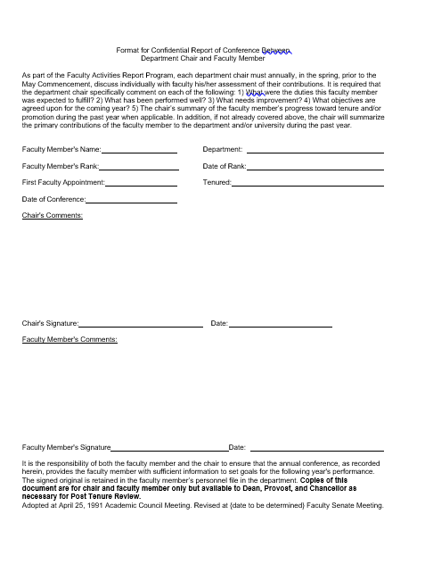
Confidential Report of Conference Between Department Chair and Faculty Member

Slide 41
Original
It is the responsibility of both the faculty member and the chair to ensure that the annual conference, as recorded herein, provides the faculty member with sufficient information to set goals for the following year's performance. Copies of this document are for chair and faculty member only but available to Dean, Vice-Chancellor for Academic Affairs, and Chancellor.
Adopted at April 25, 1991 Academic Council Meeting

Slide 42
Current (no Deans, Provost vs VCAA)
It is the responsibility of both the faculty member and the chair to ensure that the annual conference, as recorded herein, provides the faculty member with sufficient information to set goals for the following year's performance. The signed original is retained in the faculty member’s personnel file in the department. Copies of this document are for chair and faculty member only, but available to Provost, Chancellor, and as necessary for Post Tenure Review.
Adopted at April 25, 1991 Academic Council Meeting. Revised at November 20, 2008 Faculty Senate Meeting.

Slide 43
Proposed (add Deans)
It is the responsibility of both the faculty member and the chair to ensure that the annual conference, as recorded herein, provides the faculty member with sufficient information to set goals for the following year's performance. The signed original is retained in the faculty member’s personnel file in the department. Copies of this document are for chair and faculty member only but available to Dean, Provost, and Chancellor as necessary for Post Tenure Review.
Adopted at April 25, 1991 Academic Council Meeting. Revised at {date to be determined} Faculty Senate Meeting.

Slide 44
Motion to approve new wording
It is the responsibility of both the faculty member and the chair to ensure that the annual conference, as recorded herein, provides the faculty member with sufficient information to set goals for the following year's performance. The signed original is retained in the faculty member’s personnel file in the department. Copies of this document are for chair and faculty member only but available to Dean, Provost, and Chancellor as necessary for Post Tenure Review.
Adopted at April 25, 1991 Academic Council Meeting. Revised at {date to be determined} Faculty Senate Meeting.

Slide 45
Rights and responsibilities of emerita faculty
Status
Concerns
Service on graduate committees
Sponsoring new graduate students
Access to accounts (i.e. SRI accounts)
Submission and administration of proposals
Liability
Access to e-mail (loss of e-mail for set period of time?)
Requirement for time of separation after retirement
Many concerns relate to “employment” status
Waiting on clarification of policies for “rehiring” emerita and retired faculty before proceeding.

Slide 46
Agenda
V. Reports of Standing Committees
D. Intellectual Property
J. Kimball

Slide 47
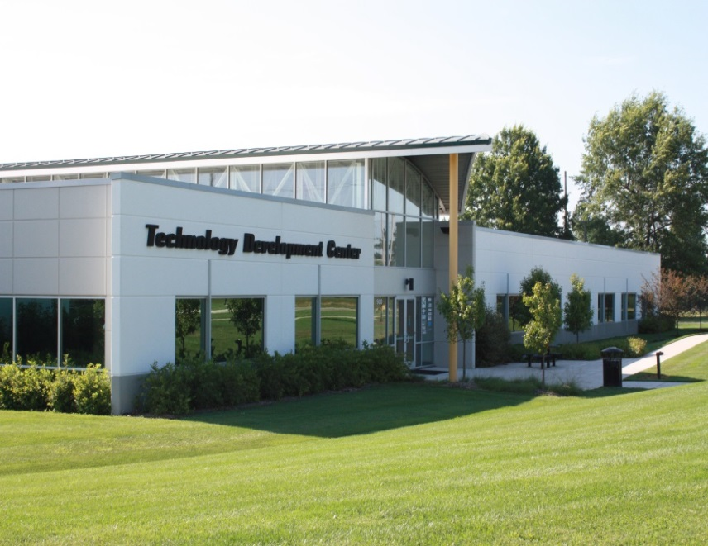
March 2020 – IP Committee Report to Faculty Senate
Office of Technology Transfer and Economic Development
ecodevo.mst.edu | businessdevelopment.mst.edu | techtransfer.mst.edu

Slide 48
Results (FY18/19/20 YTD)
Technology Transfer
Royalty Income
FY2020 YTD $631K (est. $720-$750K
FY19 $698K Record!!
FY 18 $530K
Patents & Copyrights Issued/Granted
FY2020 – 18 (10 nonUS) 1 CR
FY2019 – 34 (22 nonUS) 1CR
FY2018 – 10 (1 nonUS) 3CR
Disclosures Received
FY2020 - 24
FY2019 - 54 Record!!
FY2018 - 50 Record!!
Active License/options
32/41/46 Licenses/options
Active Case load
181/177/177 cases

Slide 49
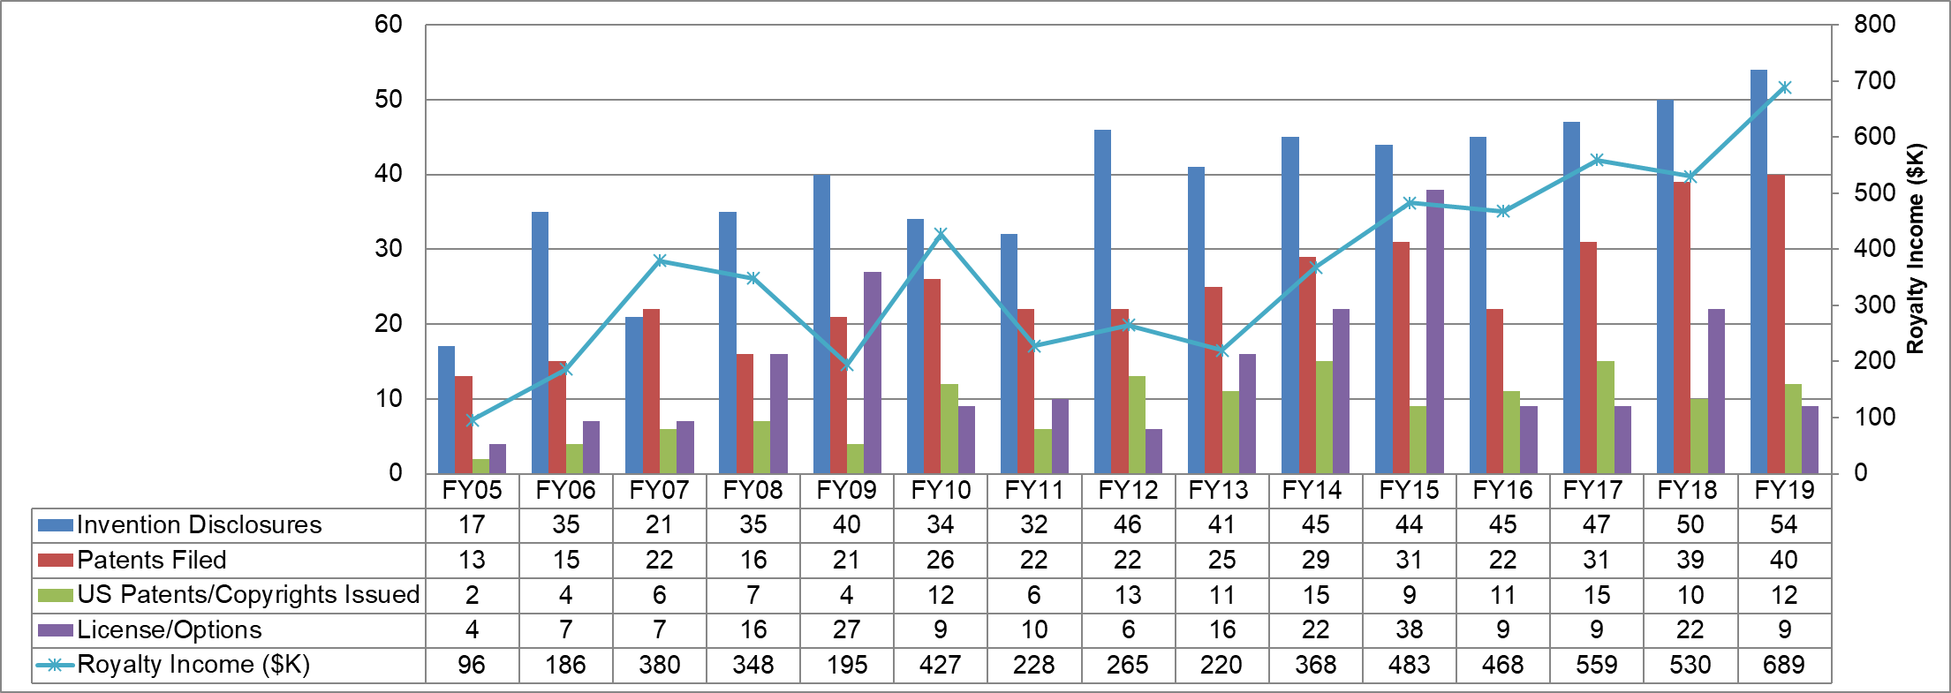
Long term TT metrics
Campus Office opened

Slide 50
TTO Comparable Schools
Metric 3 year average 16-18 | S&T | Colorado Mines | Michigan Tech | New Jersey Tech | Stevens (2018 only) | Georgia Tech
Invention Disclosures | 47 | 50 | 33 | 43 | 36 | 306
Disclosure/$Research | 1.28 | 0.83 | 0.44 | 0.30 | 1.15 | 0.39
License Income | $519,000 | $75,000 | $312,000 | $68,000 | $28,500 | $1,683K
License Income/$Research | $14,048 | $1,246 | $4,187 | $494 | $918 | $2,121
Source: 2018 AUTM STATT Database

Slide 51
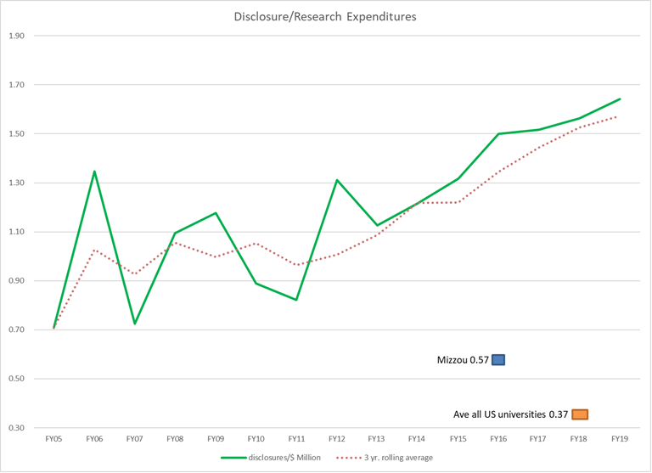

Slide 52
Patent Expenses
 | FY2017 | FY2018 | FY2019 | Ave % | F2020 YTD
Total Patent expenses | 350,747 | 322,281 | 367,187 |  | 176,878
Reimbursed patent expenses | 106,340 | 94,229 | 170,826 | 36% | 85,755 (48%)
Net patent expenses paid by University | 244,407 | 228,052 | 196,361 | 64% | 91,122 (52%)
Net patent expenses represent about 0.75% of the total research expenditures

Slide 53
Proposed Change to Patent Cash Flow
Old: All costs borne by UM System
New: All costs borne by campuses
Old: 1/3 of royalties to inventor, then patent expenses covered; then split equally among UM System, VCR, department
New: Patent expenses covered first; then 1/3 inventor, 2/3 “campus”
How is that 2/3 distributed?
Likely to be presented at April board meeting, effective for FY21

Slide 54
News Item: Keith Strassner is Leaving

Slide 55
Resolution from the Intellectual Property Committee, presented March 19, 2020
Whereas Keith Strassner joined the University of Missouri-Rolla as Director of Technology Transfer and Economic Development in 2005; and
Whereas campus royalty income from its patent portfolio has risen from less than $20,000 annually to greater than $680,000 annually under Mr. Strassner’s leadership; and
Whereas Mr. Strassner was instrumental in the development of the Missouri University of Science and Technology Innovation Park, including the Technology Development Center, a LEED Silver certified building that anchors the park; and
Whereas Mr. Strassner has demonstrated both a passion for the University’s economic development mission and a willingness to help faculty, staff, and students engage in technology transfer activities,
Be it resolved that the Faculty Senate of the Missouri University of Science and Technology does hereby sincerely thank Keith Strassner for every job well done and wish him continued success in his future endeavors.
Adopted this 19th day of March, 2019, at the meeting of the Faculty Senate of Missouri University of Science and Technology.

Slide 56
Agenda
V. Reports of Standing Committees
E. Information Technology/Computing
J. Singler

Slide 57
Informational items from the ITCC
CIO search
Three finalists interviewed Monday and Tuesday (3/16-17)
We hope the process will be complete soon
Cloud based tools and storage
Microsoft Office 365 is coming after further testing
More below; all Google tools will remain
Google Drive and OneDrive will be available for storage
We will be able to use both for flexibility
Both have very strong security certifications
Sync tools will be available

Slide 58
Cloud based storage and tools
Microsoft Office O365 is coming after further testing
Standardized email and calendaring across all campuses
Desktop, web, and mobile versions of applications
Outlook, Word, Excel, PowerPoint, etc.
Real time co-authoring of documents
Sync tools and sharing options
Will include new tools for two factor authentication (TFA)
We currently use SecureAuth for TFA, which is expensive
New TFA tools will require minor changes, but will save money
Physical USB security keys recommended to minimize disruption, while maintaining security

Slide 59
Agenda
V. Reports of Standing Committees
Budgetary Affairs M. Fitch
-No Report

Slide 60
Agenda
VI. Administrative Reports
A. Chancellor’s Report
M. Dehghani

Slide 61
Agenda
VI. Administrative Reports
B. Provost’s Report
S. Roberts

Slide 62
Agenda
New Business

Slide 63
Agenda
VIII. Adjourn
63

